Slide 1

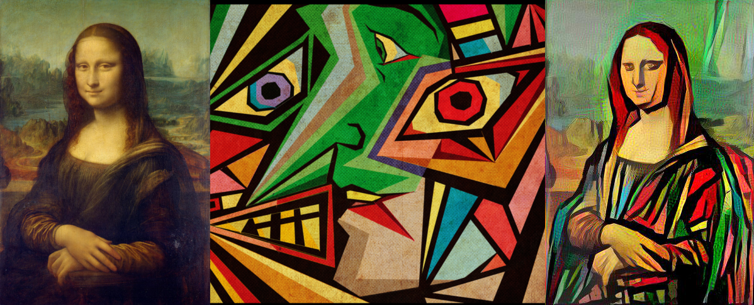
NEURAL STYLE TRANSFER

Slide 2

RESEARCH SYNOPSIS PREESENTATION
GUIDE :
Mr. AKASH GOEL
(Assistant Professor)
TEAM MEMBERS:
PALAK SINGH(2000290120103)
RAGINI RANI (2000290120121)
KALASH JAIN (2000290120080)

Slide 3
INTRODUCTION
Our project is about Neural style transfer, It is a technique that we are used to optimizing images that take two input images first one is the content image and the second one is style image, combine these two images and form the output image which looks like a content image but style of the new image is different. In this, we present different estimation techniques and analyze different Neural style transfer algorithms for loss function that is content loss and style loss. In the content loss, it guarantees that the new image does not differ far from the theme of the content image whereas style loss maintains the stylistic difference of the style image. It is based on Convolutional Neural Networks (CNNs), a deep neural network class that is specifically suitable for image processing.

Slide 4

PROBLEM STATEMENT
One of the most interesting deep learning approaches is neural style transfer (NST). As can be seen in the above picture, it merges two images, namely, a content image and a style image, to create a new image by combining a content image and a style image.
The following data must be provided to the image style transfer model as inputs:
• A content image is an image that we wish to add style to.
• A style image is the look we want the content image to have.
• A produced output image is the combined result of the content and style images.

Slide 5
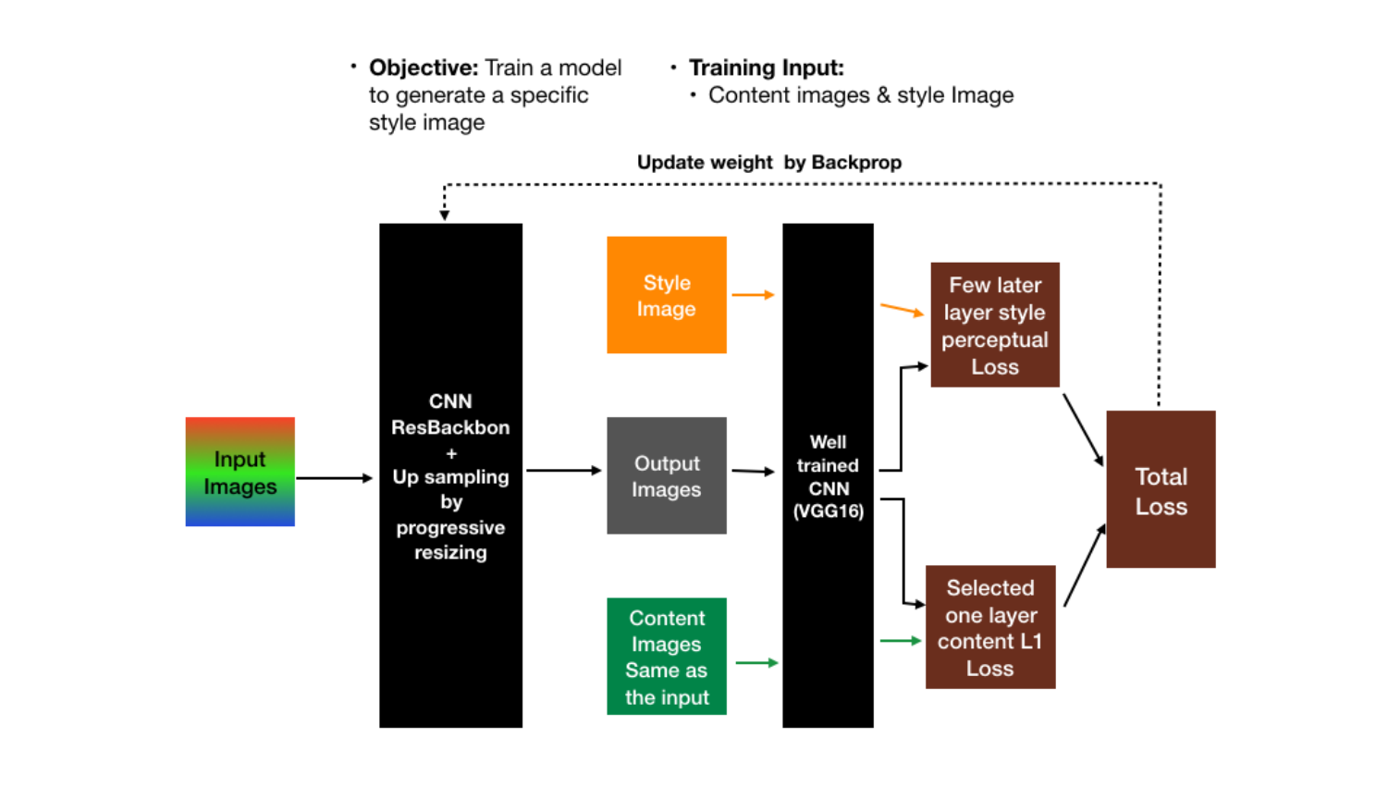
Flowchart

Slide 6
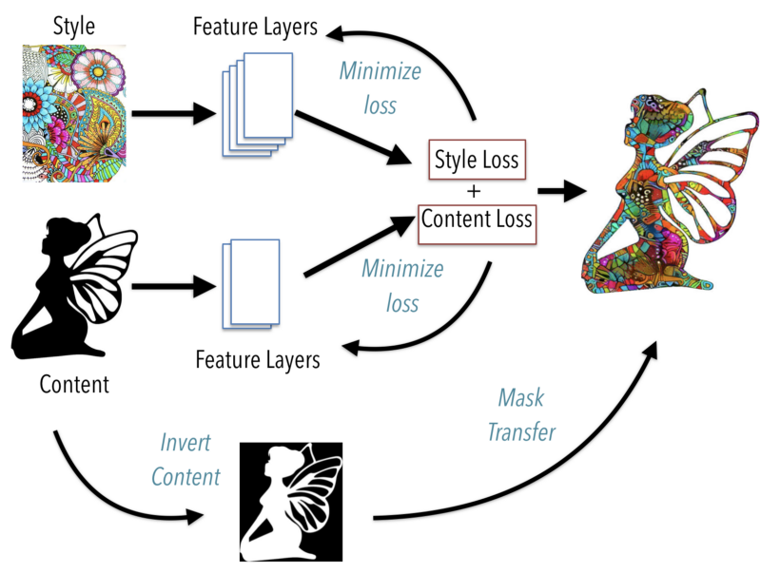
Analysis

Slide 7
OBJECTIVE
To investigate neural style transfer through implementation.
To transfer style and content from two pictures to and create a new image with the features we want to add.
To enable the Deep learning model to distinguish between the style representation and content image

Slide 8
SCOPE
We can use our project in an app that enables you to add the painting techniques of well-known painters to your own images. The results are rather eye-catching. It is not like Instagram filters, which just alter the image's color space, this alteration affects the entire image. It is far more complex, and the outcomes are even more interesting.
Gaming
Commercial Art
Virtual Reality
Photo and video editing

Slide 9
TECHNOLOGY USED
Keras
Pytorch
Numpy
h5py
Scipy +PIL +Scikit-Image
Tensorflow

Slide 10
CONCLUSION
This technique helps to recreate the content image in the style of the reference image. It uses Neural Networks to apply the artistic style from one image to another due to which it shows the result of high perceptual quality. Neural style transfer opens up endless possibilities in design, content generation, and the development of creative tools.
Our study illustrates the advantages of combining international and local losses in the transfer of image style. Fusion architecture refers to designed. A style loss function based on a local method specified in numerous layers is employed on the one hand to maintain the detailed designs

Slide 11
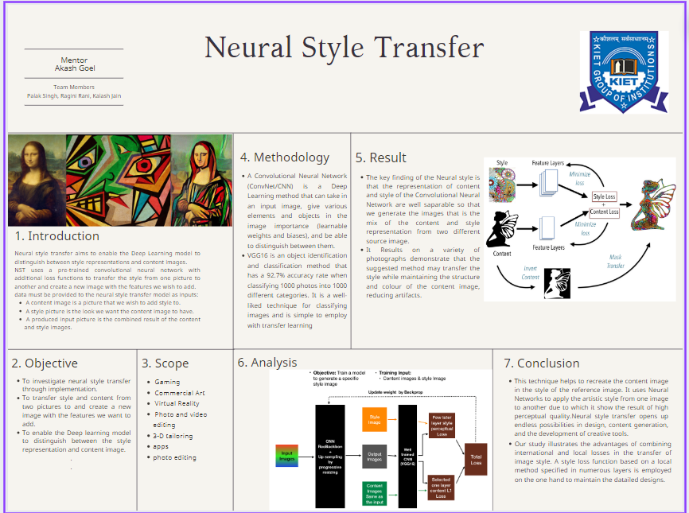
POSTER

Slide 12


